Slide 1

A JAVA-based ATM Interface with JDBC Connection and Advanced Features
CORE JAVA PROJECT
By SURENDHARAN

Slide 2
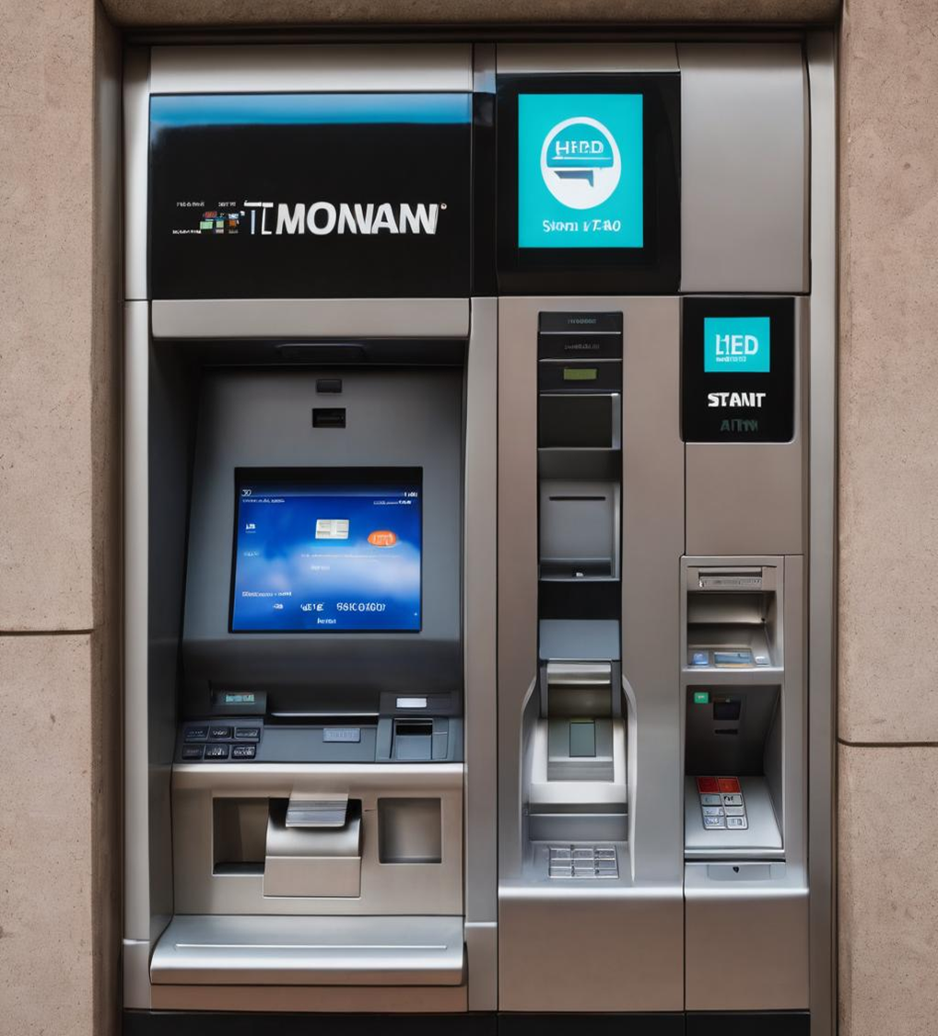
INTRODUCTION
This presentation aims to introduce a JAVA-based ATM interface with JDBC connection and advanced features.
The project simulates an ATM (Automated Teller Machine) interface using Java and a MySQL database.
It allows users to interact with the ATM through a command-line interface, performing various banking operations such as checking balance, opening an account, depositing money, withdrawing money, and generating a mini statement.

Slide 3
Contents
Main Class (AtmMain)
ATM Operations (AtmOperations)
Transaction Statement (TransactionStatement)
Database Connection (DatabaseConnection)
MySQL Tables (Account table and Transaction Table)

Slide 4

Main class
Acts as the entry point of the application.
Displays the main menu with options for different operations.
Based on user input, it calls the respective methods from the AtmOperations or TransactionStatement classes to execute the choen operation.

Slide 5

Atm operations
Contains methods for essential ATM operations like checking balance, registering a new account, depositing money, and withdrawing money.
Utilizes the DatabaseConnection class to connect to the MySQL database and perform database operations.

Slide 6
ATM Operations Functions
inputandvalidateAccountNo:
Takes user input for an account number and validates its length.
inputandvalidatePin:
Takes user input for a 4-digit PIN and validates its length.
inputandvalidateAmount:
Takes user input for an amount and validates it.
inputandvalidateMobileNo:
Takes user input for a mobile number and validates its length and first digit.
hasAccNoInDatabase:
Verifies whether the account number exists in the database.
hasPinInAccount:
Verifies whether the PIN exists for a given account number.
checkBalance:
Allows the user to check their account balance.
register:
Allows a new user to register and create a new account.
deposit:
Allows the user to deposit money into their account.
withdraw:
Allows the user to withdraw money from their account.
getBalance:
Helper method to get the account balance.

Slide 7

TRANSACTION STATEMENT
Handles generating custom transaction statements based on user input for a specific date and time range.
Uses SQL queries to fetch transaction data from the database for the specified date and time range.
getCustomTransactionStatement:
Allows the user to generate a custom transaction statement within a specific date and time range.

Slide 8
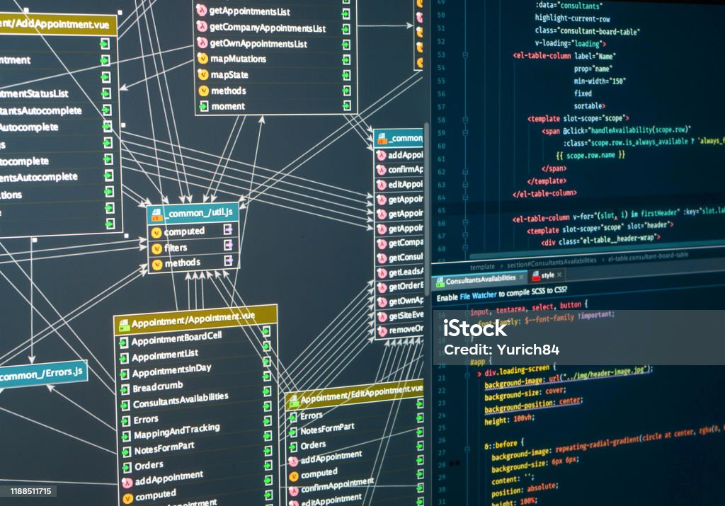
DATABASE CONNECTION
Provides a connection to the MySQL database.
Manages database connection, ensuring it's established and closed properly.
getConnection:
Establishes a connection to the MySQL database.
private static String driver = "com.mysql.cj.jdbc.Driver";
private static String url = "jdbc:mysql://localhost:3306/atm_db";
Used the JDBC Driver class to for the MySQL connection and connected with the atm_db database created in the MySQL for this project.

Slide 9
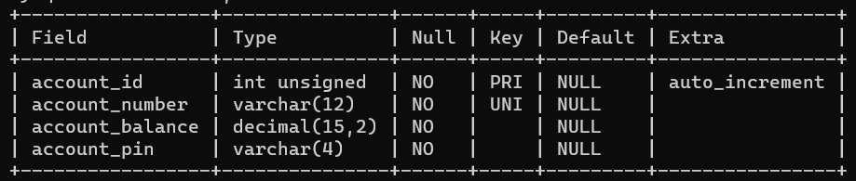
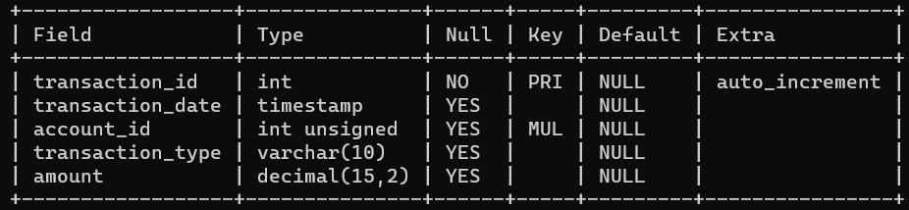
Database tables
The database consists of two tables which are:
ACCOUNT TABLE
Stores account information including account id, account number, balance, and PIN.
TRANSACTION TABLE
Stores transaction information including transaction ID, date, account ID, transaction type, and amount.

Slide 10
working
The ATM interface project begins with the user interacting through the AtmMain class, which serves as the entry point.
The user is presented with a menu to choose from options like checking balance, opening an account, depositing, withdrawing, or generating a mini statement.
The core functionalities are implemented in the AtmOperations class, where the user's inputs, like account number, PIN, and amount, are validated.
The operations such as checking balance, registration, depositing, and withdrawing are handled here, with appropriate updates to the database.
The TransactionStatement class enables users to generate custom transaction statements based on specified date and time ranges.
The MySQL database stores account and transaction data, ensuring data persistence.
Overall, the project emulates a basic ATM system, allowing users to manage their accounts and transactions effectively

Slide 11

conclusion
In conclusion, the ATM interface project successfully emulates essential functionalities of a real-world ATM system.
Users can perform vital banking operations like checking their account balance, registering new accounts, depositing, and withdrawing money.
The system also provides a feature to generate a custom transaction statement within specific date and time ranges, enhancing user convenience.
The project showcases effective use of Java programming and SQL database management.
The seamless integration of user interaction, business logic, and data management showcases a well-structured and functional ATM interface.

Slide 12
Thank you!

